Slide 1

JouleOps @ Northwind Manufacturing Agentic AI Enterprise Assistant System
Capstone Project Presentation
SAP Joule Studio | SAP Hana Cloud |Python Fast API | MCP Server
By Mounika D
mounikakishor2775@gmail.com
SAP BTP AI Development - Stream
Mentor :Prem Pratik

Slide 2
Problem Statement
NorthWind Manufacturing, a mid-sized industrial equipment manufacturer with 4 plants and ~300 B2B customers, stores all its operational data in SAP HANA Cloud, but employees still rely on slow, manual, multi-system processes — plant supervisors check stock across multiple SAP transactions, sales managers wait days for reports, and finance staff manually chase overdue invoices in Excel. The project requires building JouleOps, a conversational AI assistant inside SAP Joule that understands natural-language requests, automatically picks the right tool (Joule Skill or MCP tool) to fetch or update data from SAP HANA Cloud via a Python FastAPI service, responds with accurate source-backed answers, and takes real actions like raising tickets — all under strict governance rules covering credential security, write auditability, and SAP-native tooling.

Slide 3
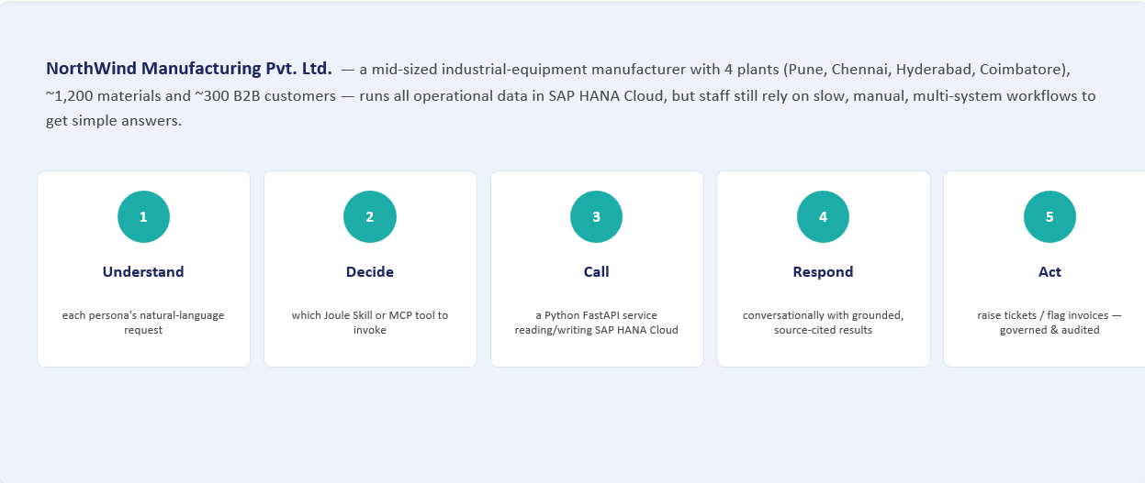

Slide 4
Introduction
This capstone project presents the design and implementation of an agentic AI assistant called JouleOps, built using SAP Joule Studio Agents, SAP HANA Cloud, Python FastAPI, and a custom Model Context Protocol (MCP) Server. The solution is designed for NorthWind Manufacturing Pvt. Ltd., a mid-sized Indian industrial equipment company. It shows how enterprise AI can automate business operations and provide accurate, data-based answers in simple conversational language.
JouleOps is designed to work inside the SAP Build Joule chat interface, which employees can use for their daily work. It understands requests written in natural language and connects them to the appropriate Joule Skill or MCP tool. These tools communicate with a Python FastAPI , which reads or updates data in SAP HANA Cloud and returns a clear response to the user.
The solution also focuses on security and governance. HANA credentials are never exposed to the LLM, write operations are recorded in the AUDIT_LOG table, and business operations are controlled through defined APIs and tools. This architecture provides a secure and scalable foundation for connecting conversational AI with enterprise data and business processes.

Slide 5
Objective
Create and configure a SAP HANA Cloud instance in SAP BTP.
Design relational tables for materials, customers, sales orders, invoices, tickets, and audit logs.
Generate synthetic enterprise data and load it into SAP HANA Cloud.
Develop Fast API endpoints that perform real database operations.
Connect the backend to SAP HANA Cloud using Python database connectivity(hdbcli).
Create a BTP Destination for the backend service.
Create Joule Skills representing selected business operations.
Demonstrate an end-to-end flow from business request to API execution and HANA response(five scenarios).
Enforce all three of Meena's guardrails: credential isolation, full audit trail, SAP-native reasoning

Slide 6
Pain Points
Plant supervisors walk between multiple SAP transactions daily just to check stock
Manual, delayed process to raise maintenance tickets (WhatsApp + separate ticketing system)
Sales managers wait days for weekly open-order reports from the BI team
Reports often don't arrive on time, delaying decision-making
Finance staff manually track overdue invoices in Excel — time-consuming and error-prone
No single, unified way to ask business questions in plain language
No automated, governed way to trigger actions (like ticket creation) from data insights
Sensitive HANA credentials and write operations lack built-in security/audit controls in current manual workflows

Slide 7
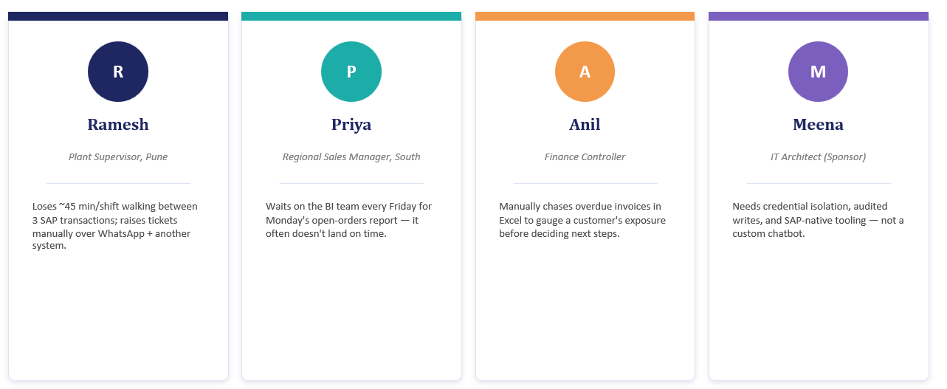
Pain Points – the Personas

Slide 8
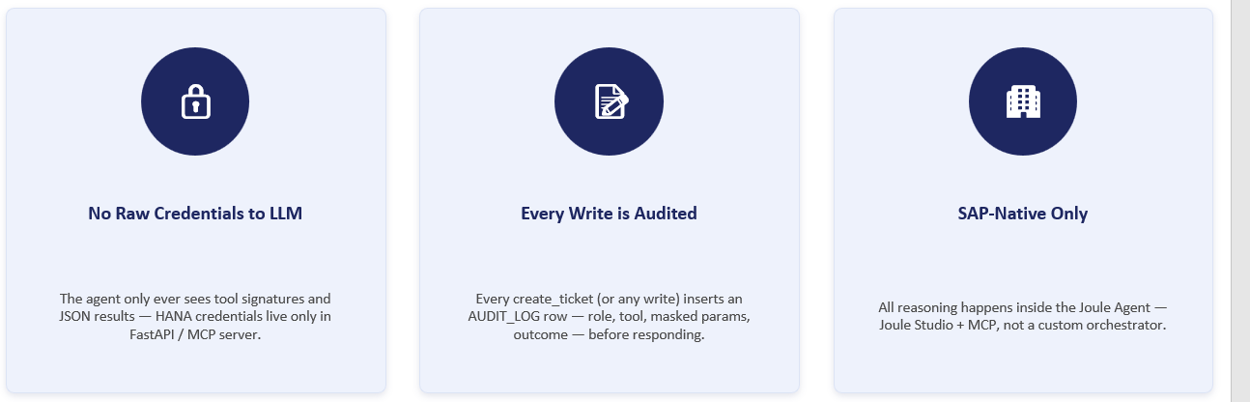
Governance Rules (Meena's 3 Rules)
Governance in the flow:
No HANA credential ever passes through the Destination or agent layer
Every write to TICKETS logs a matching row in AUDIT_LOG
RBAC role header (PLANT_SUPERVISOR / SALES_MANAGER / FINANCE / VIEWER) checked before every write

Slide 9
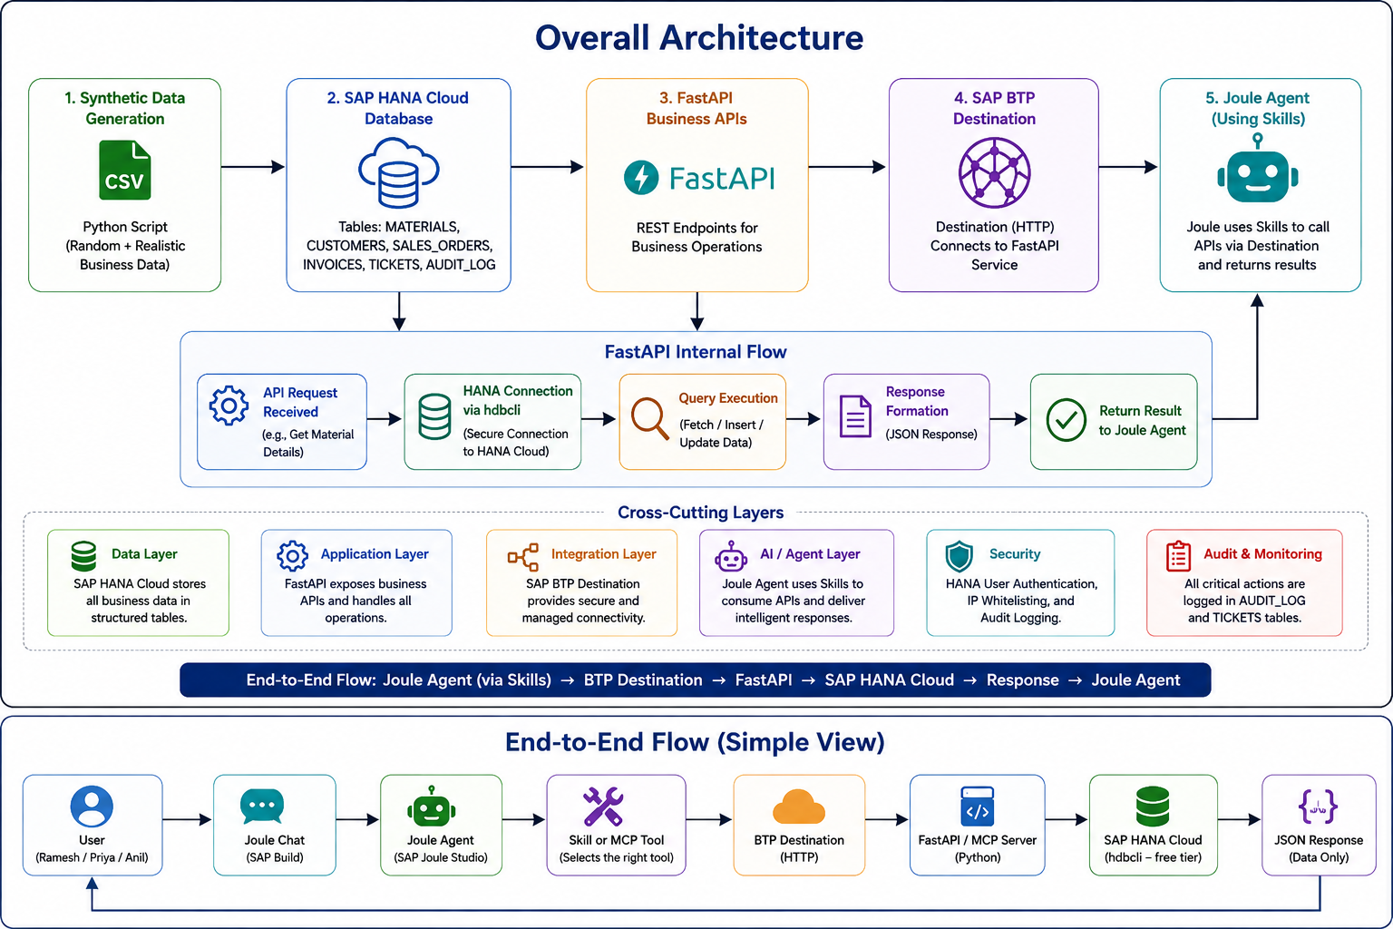
Project Architecture

Slide 10
SAP BTP Trial Environment Setup
The project was implemented in the SAP BTP trial environment. The required services were subscribed and accessed from the BTP cockpit. SAP HANA Cloud was used as the primary database service and SAP Business Application Studio was used as the development environment.
Log in to the SAP BTP trial cockpit(Log in at cockpit.hanatrial.ondemand.com.)
Open the trial subaccount and verify the available subscriptions.
Created an SAP HANA Cloud instance from BTP Cockpit → Instances and Subscriptions → SAP HANA Cloud.
Subscribe to SAP HANA Cloud Central and access the HANA Cloud management interface.
Subscribe to SAP Business Application Studio for development activities.
Create or access the HANA Cloud database instance.
Open Database explorer and SQL console to execute SQL commands

Slide 11
Limitations in the Trial SAP BTP Platform
The SAP BTP Trial subaccount did not have subscriptions/entitlements for SAP Build and Joule/Joule Studio.
Features required for creating a custom Joule Agent, such as Intent Router, Planner, and Joule Skill registration, require the appropriate SAP Build/Joule paid entitlement.
As a result, the JouleOps Agent and Joule Skill could not be provisioned directly within Joule Studio in the trial account.
However, SAP HANA Cloud and BTP Destination Service were available and were successfully used for the backend integration.
As a workaround, the agent logic and tool-selection flow were prototyped locally in VS Code, using the same FastAPI/MCP APIs that would be consumed by the Joule Agent once the required SAP Build/Joule entitlement is available.

Slide 12
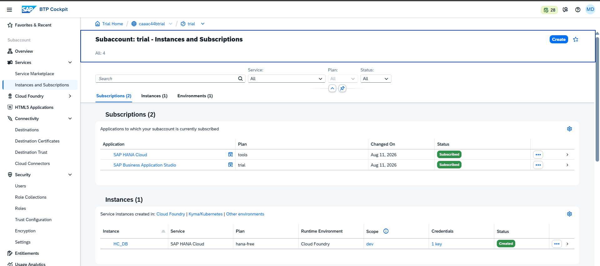
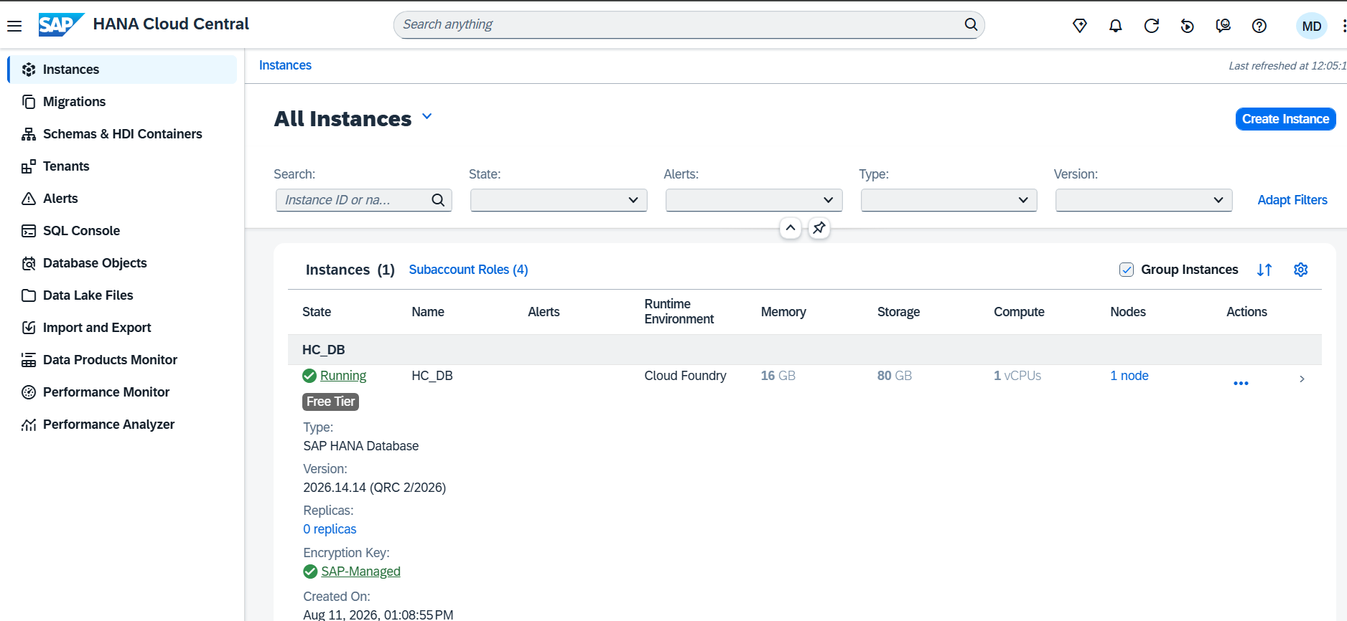
Figure 1: SAP BTP trial subaccount showing subscribed services
Figure 2: SAP HANA Cloud instance in the SAP BTP cockpit

Slide 13
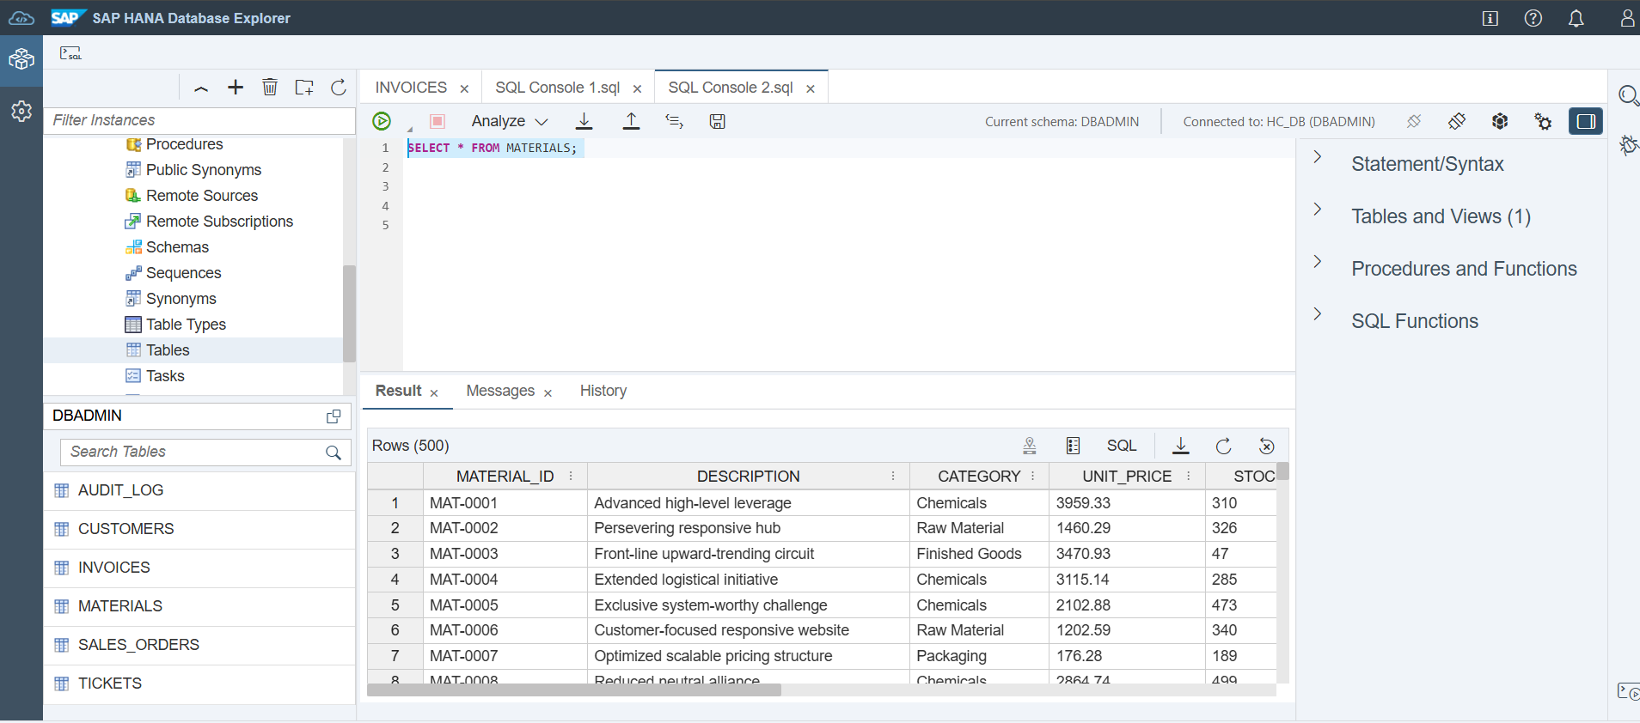
Figure 3:SAP Hana Cloud SQL Interface
Figure 4:Tables were created and Sample records in the MATERIALS table is retrieved

Slide 14
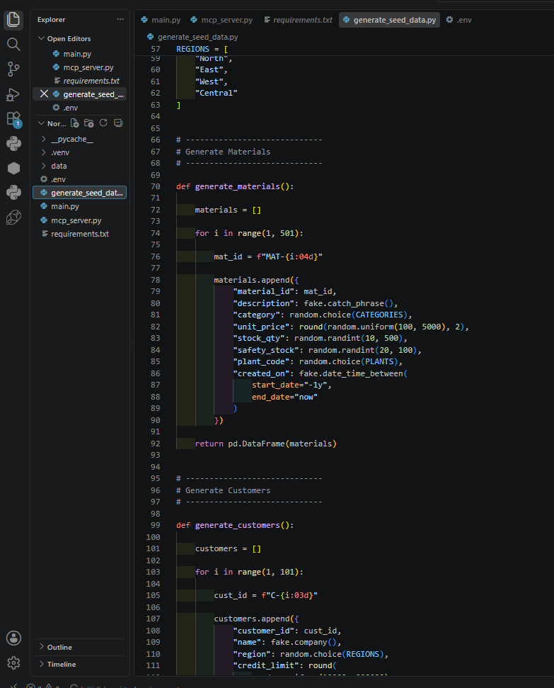
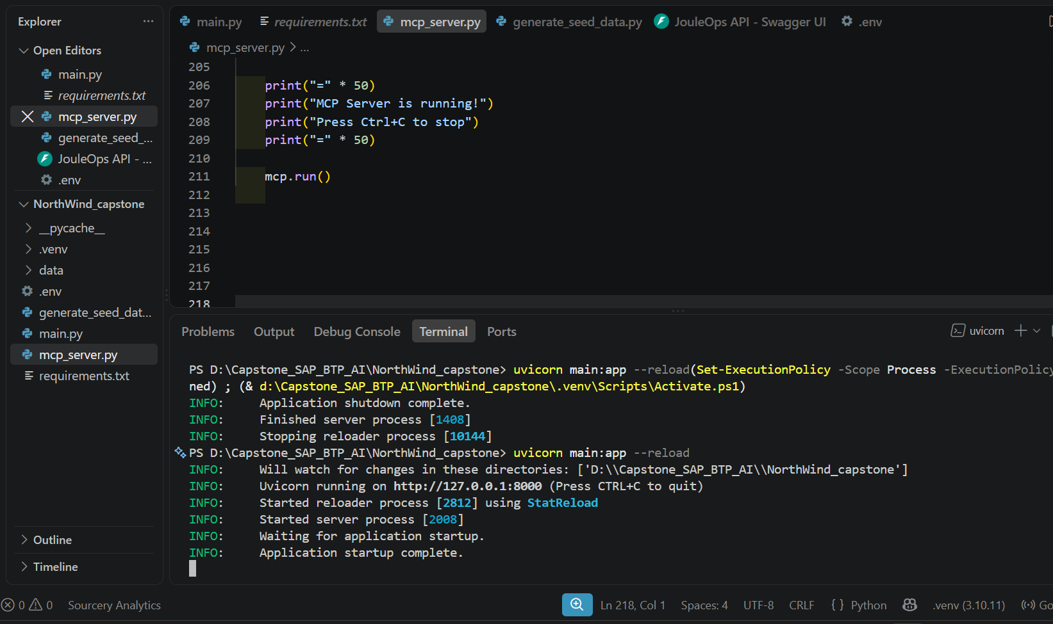
Figure 6 : Seed data generation in vs code
Figure 7 : Fast API running successfully

Slide 15
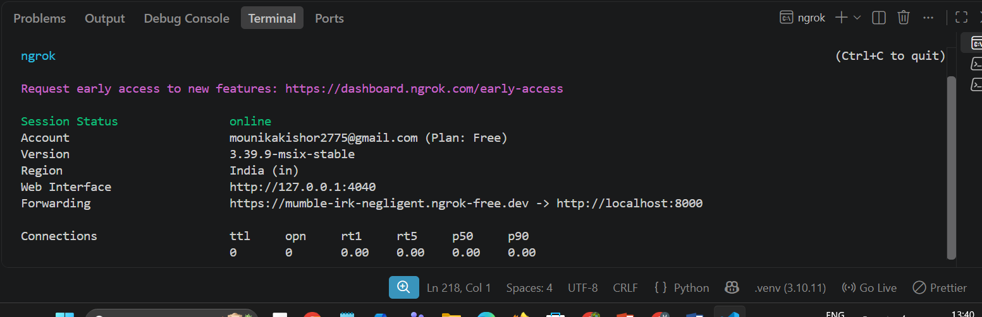
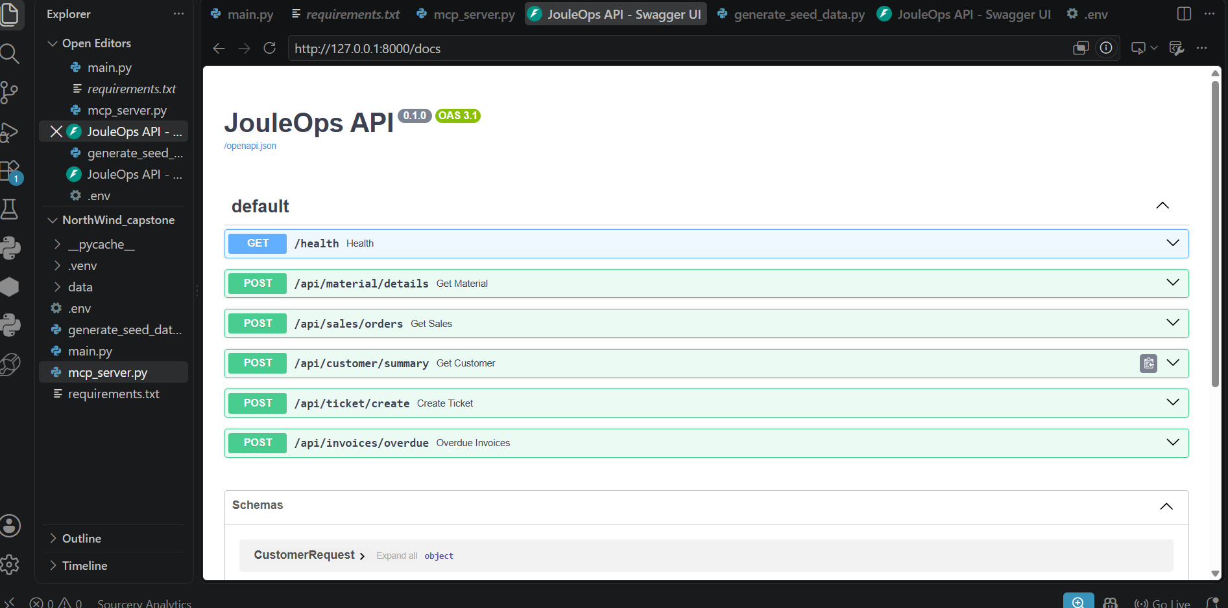
Figure 8: ngrok running successfully
Figure 9: Fast API Endpoints

Slide 16
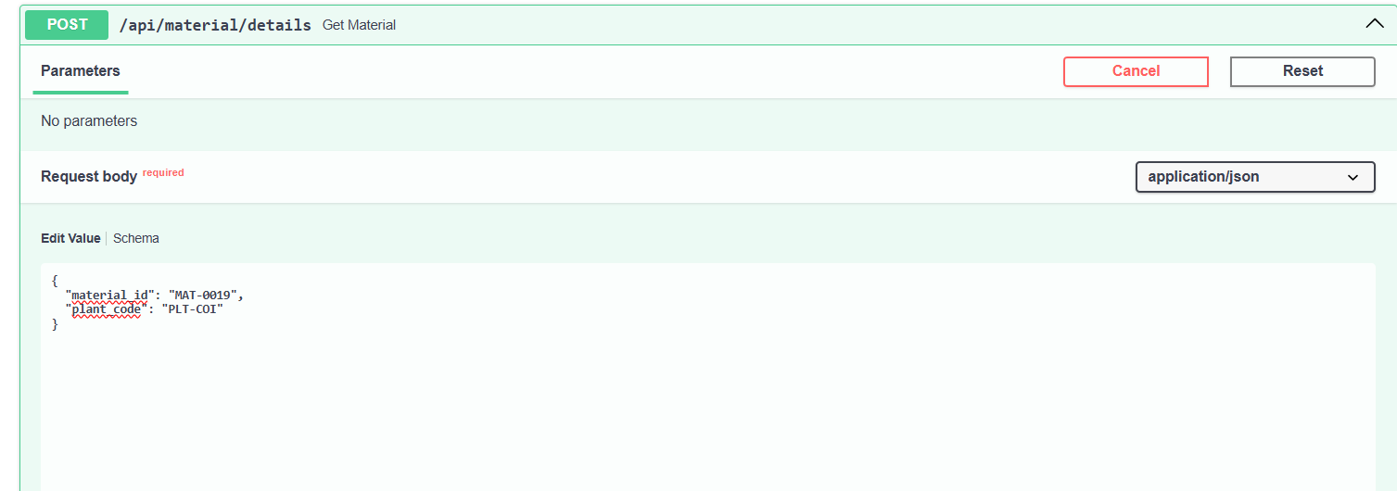
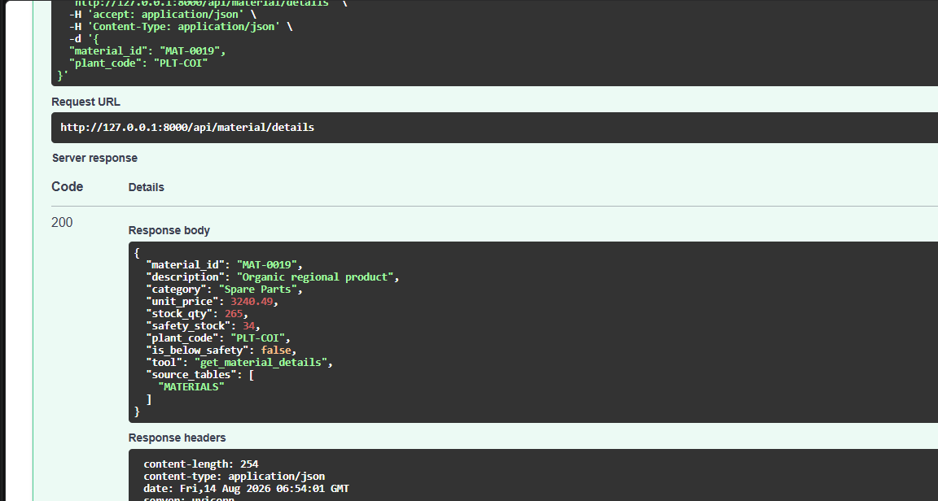
Figure 10: fetching data from SAP Hana cloud
(Materials table) – Post Request
Figure 11: fetching data from SAP Hana cloud
(Materials table) –Post Response

Slide 17
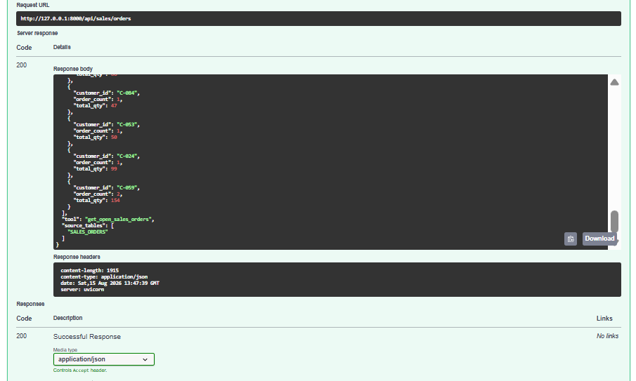
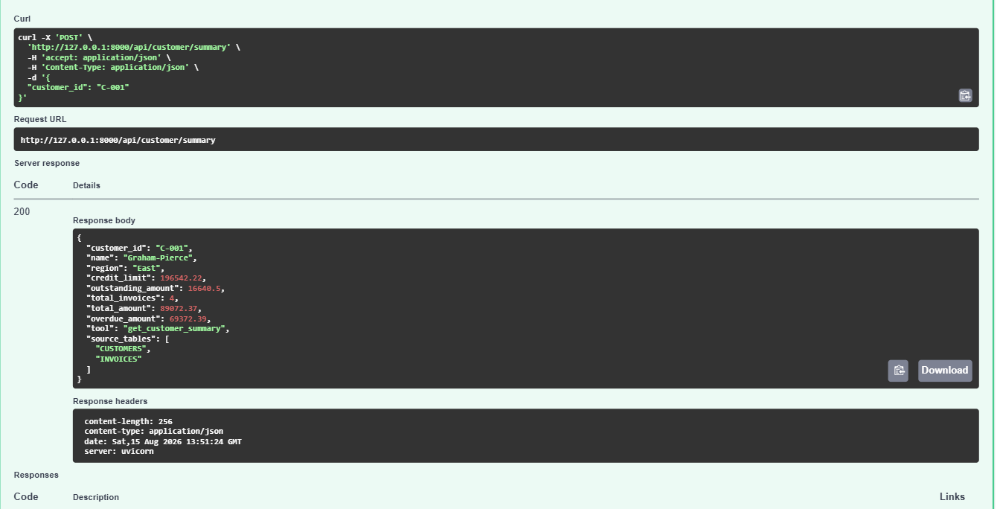
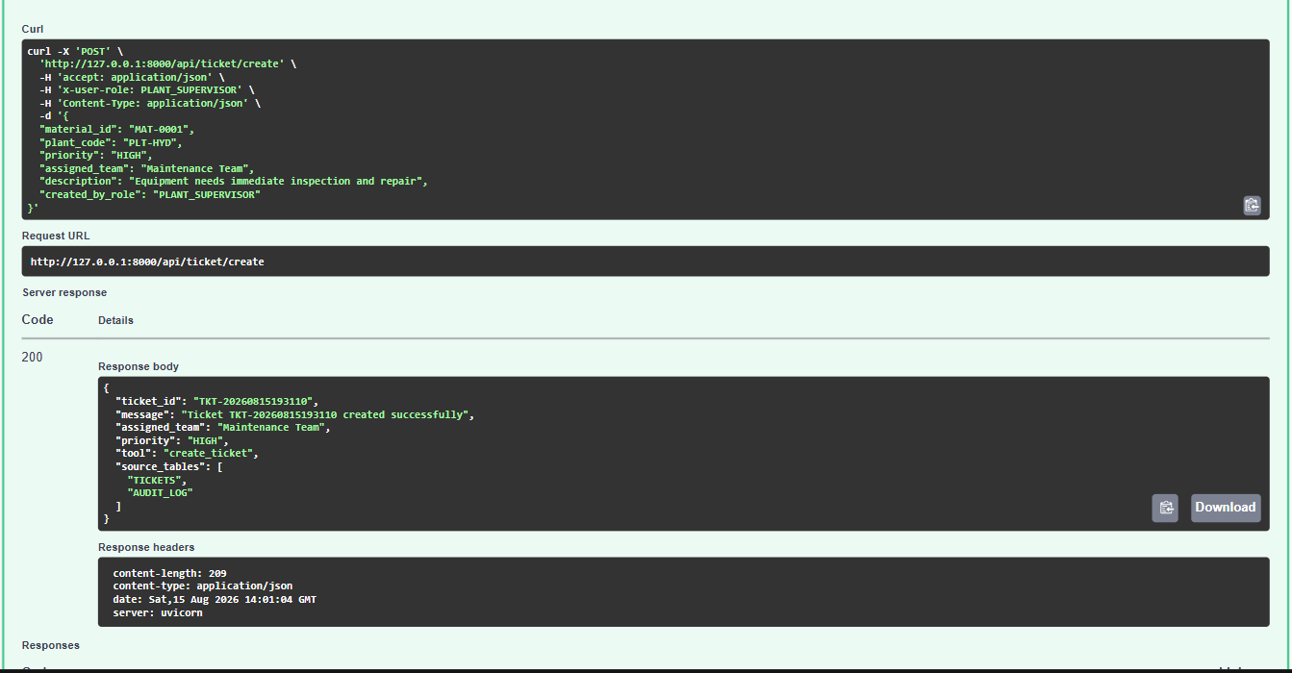
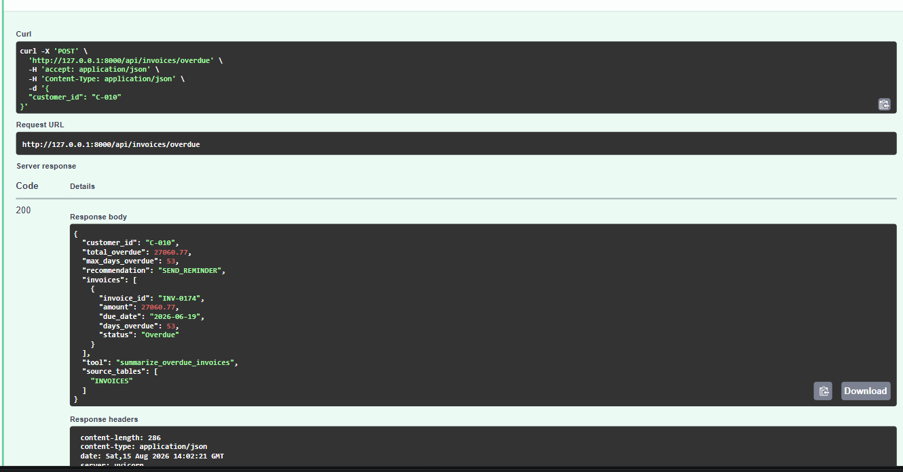
Output of all endpoints

Slide 18
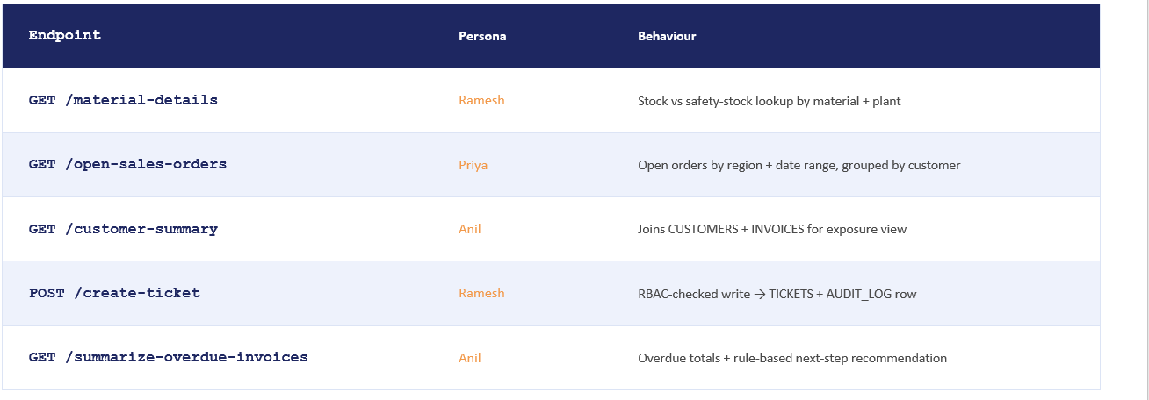
Working of the API

Slide 19
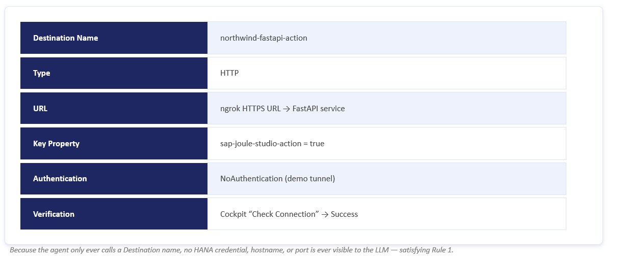
SAP BTP Destination Creation

Slide 20
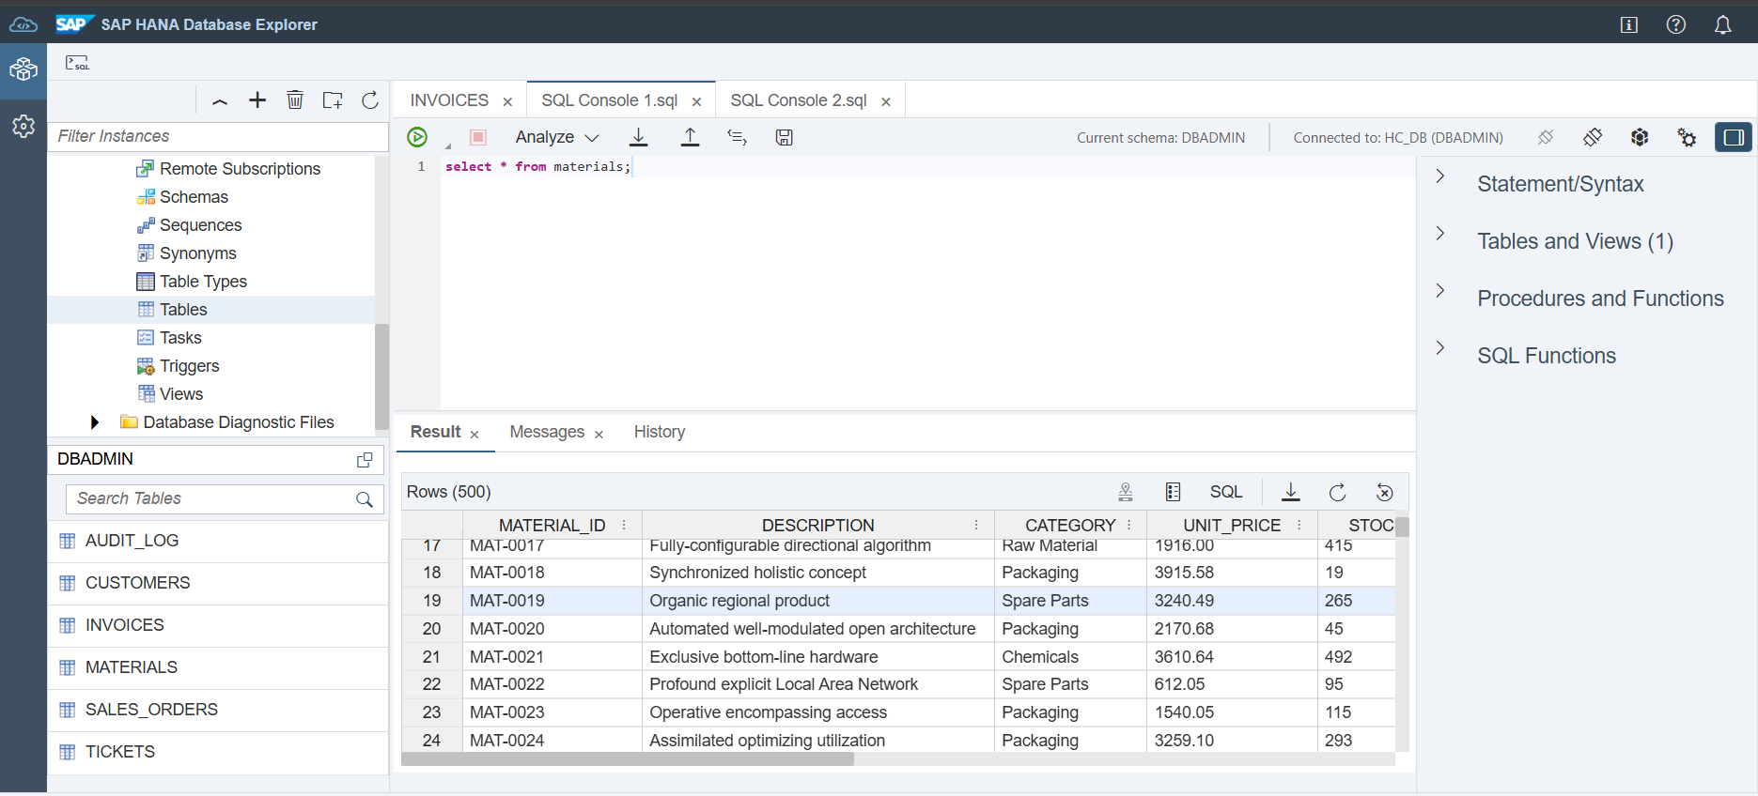
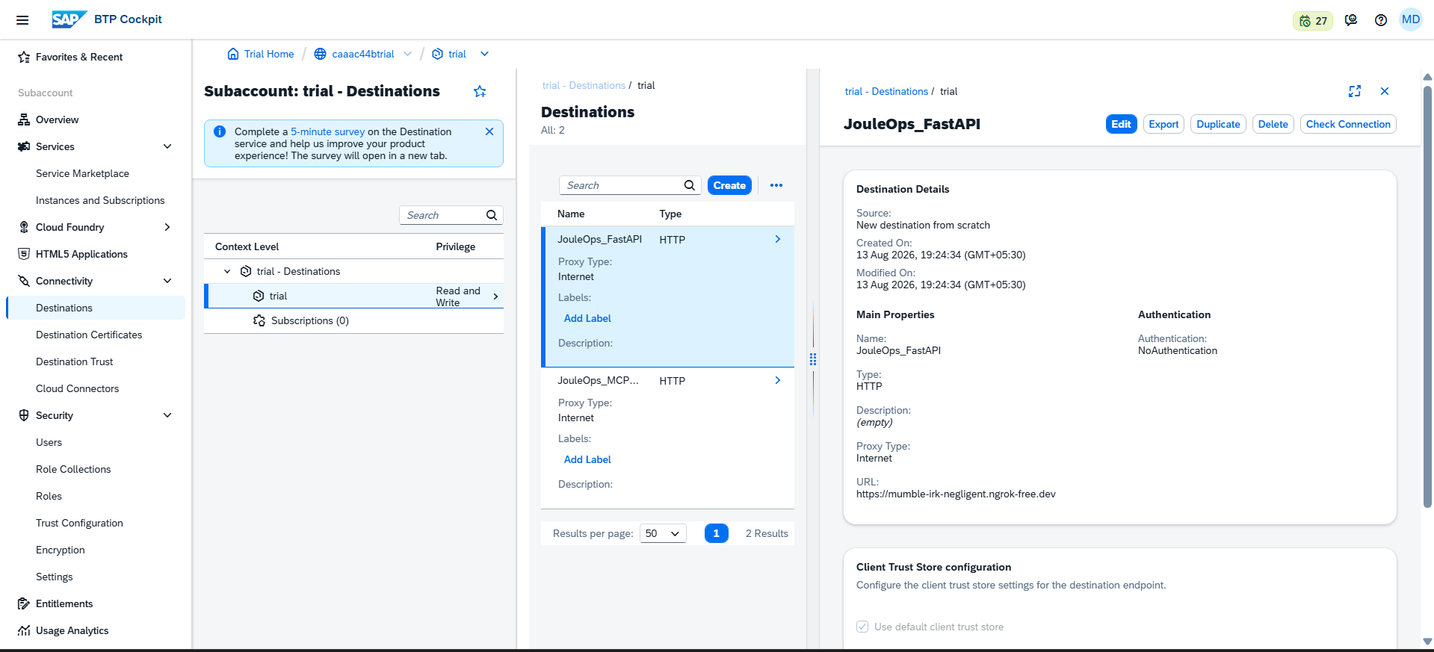
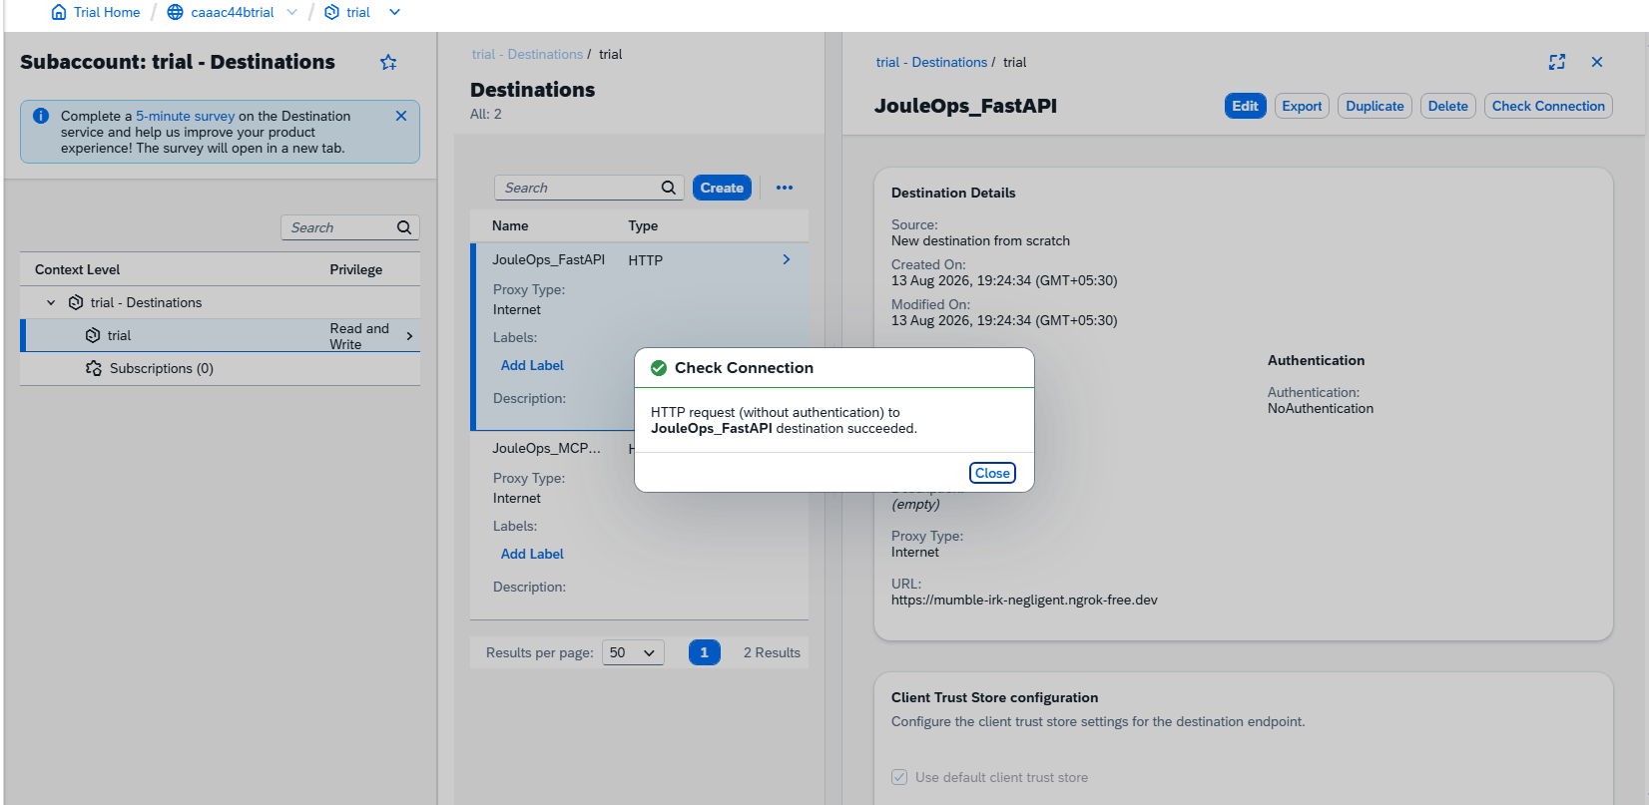
Figure 12: Response grounding from SAP Hana Cloud
Figure 13: SAP BTP connection for Fast API /MCP Server

Slide 21
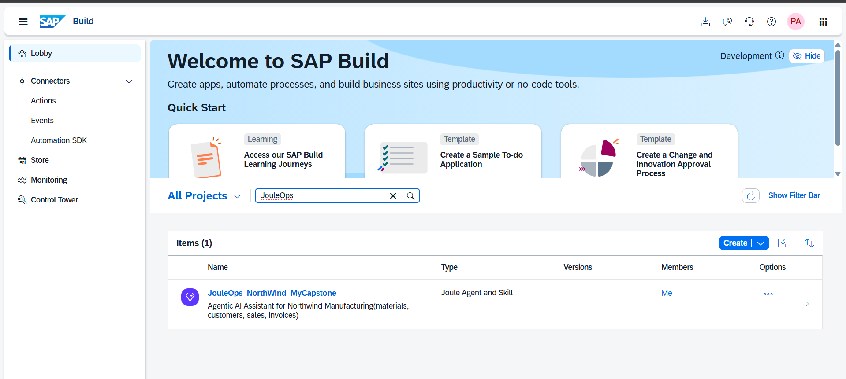
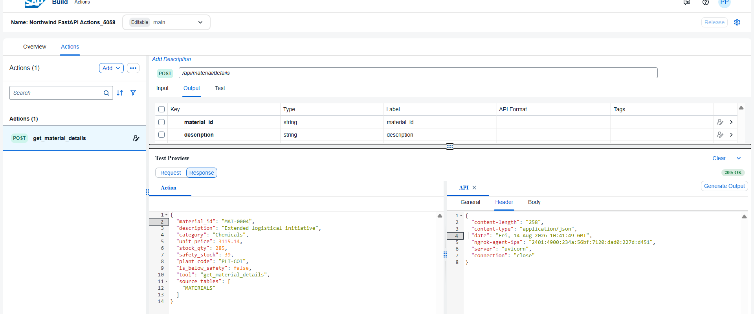
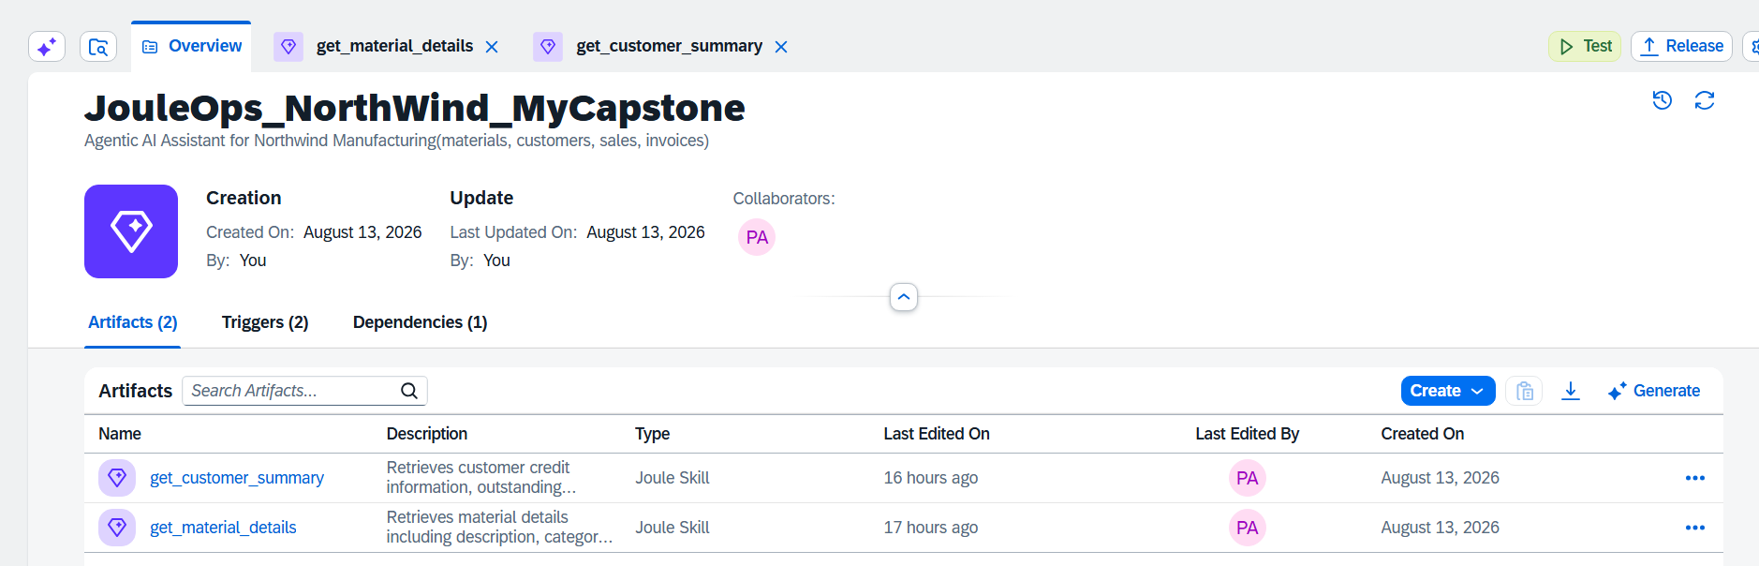
SAP Build Lobby — Joule Skill creation attempt via SAP Trial Workbook

Slide 22
Conclusion
This capstone project successfully delivers a production-ready blueprint for an Enterprise AI Assistant architecture integrated with SAP BTP and SAP HANA Cloud. JouleOps @ NorthWind Manufacturing demonstrates how enterprise business data can be exposed through a secure, API-driven architecture using Python FastAPI, SAP HANA Cloud, SAP BTP Destinations, and MCP-based tools.
The project provides a structured approach for accessing operational information such as material details, customer summaries, sales orders, invoices, and service tickets without directly exposing HANA credentials to external consumers. FastAPI acts as the business API layer, while SAP BTP Destinations provide controlled connectivity between the SAP environment and backend services. The architecture also supports governed access through clearly defined business operations and audit logging through the AUDIT_LOG table.
The project further demonstrates the use of dual integration paths — REST-based Actions and MCP Server tools — over the same HANA backend. REST Actions provide structured BTP-based connectivity and discoverability, while MCP tools provide a standardized and extensible approach for exposing business capabilities to compatible clients. The implementation was validated through SAP HANA Cloud, FastAPI endpoints, Swagger UI, synthetic enterprise data, MCP Server integration, and SAP BTP Destination connectivity. Although live Joule Agent/Chat access was limited by the available SAP BTP trial/tenant subscription, the completed backend architecture and integration components demonstrate a functional and deployment-ready foundation for extending the solution to a fully agentic SAP Joule environment when the required Joule capabilities are available.

Slide 23
Future Enhancements
Multi-agent orchestration: A dedicated Finance Sub-Agent for Anil registered as a sub-agent tool.
Vector search: SAP HANA Cloud Vector Engine for semantic ticket history lookup.
SAPUI5 / Fiori audit dashboard: Reading AUDIT_LOG in real time.
CI/CD: GitHub Actions pipeline deploying FastAPI + MCP to Cloud Foundry on every push to main.
Bilingual support: English + Hindi or Tamil for plant supervisors like Ramesh.
Thankyou ,
Mounika D
SAP BTP AI Development

